Slide 1
INTRODUCTION TO TBW. COMMUNICATION IN THE WORKPLACE

Slide 2
Expectations from the course.
Why is this course important?

Slide 3
COMMUNICATION
Communication
Transfer of information and meanings between senders and receivers
The essence is SHARING
providing data, information, insights, and inspiration in an exchange that benefits all parties involved.

Slide 4
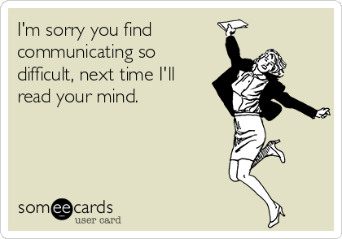
WHY DO GOOD COMMUNICATION SKILLS MATTER?
Communication is important to your career

Slide 5
The world is full of good marketing strategists, good accountants, good engineers, and good attorneys—but it is not full of good communicators.

Slide 6
If you learn to write well, speak well, listen well, and recognize the appropriate way to communicate in any situation, you’ll gain a major advantage that will serve you throughout your career.

Slide 7
WHY DO GOOD COMMUNICATION SKILLS MATTER?
Communication is important to your company

Slide 8
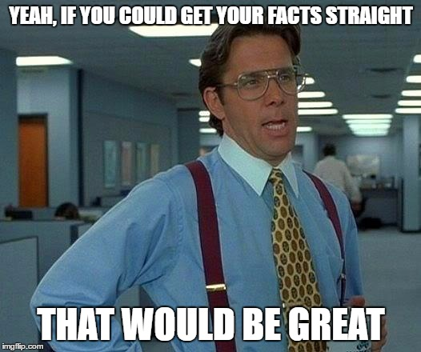
WHAT MAKES TECHNICAL AND BUSINESS COMMUNICATION EFFECTIVE?
Effective communication
Provide accurate information
Facts and concrete information
Concise
Clarifies expectations and responsibilities
Compelling, persuasive arguments and recommendations

Slide 9
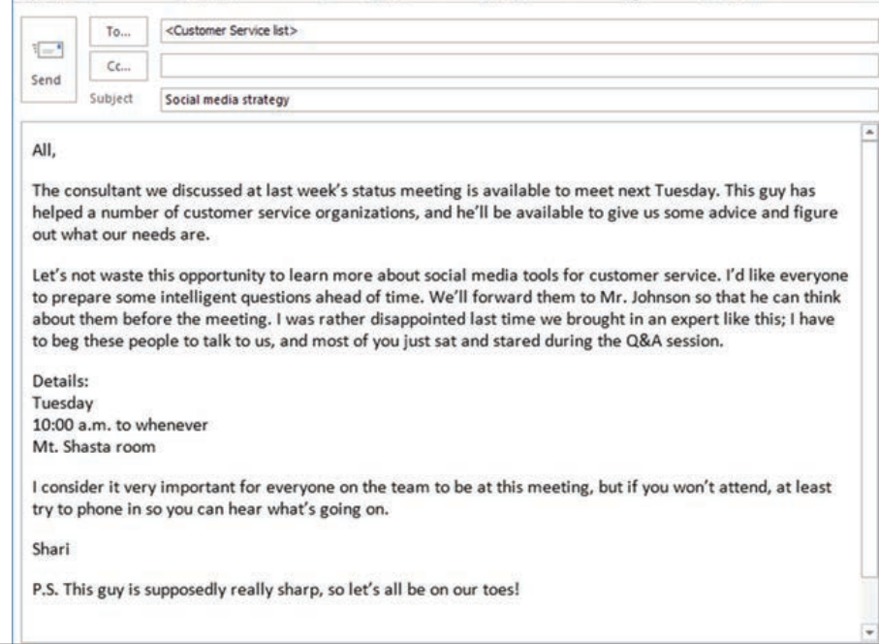
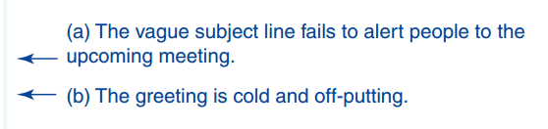

Slide 11
(c) The opening paragraph fails to provide necessary
background information for anyone who missed the
meeting.
(d) A negative, accusatory tone puts readers on the
defensive, and the request for action fails to clarify
who needs to do what by when.

Slide 12


Slide 13
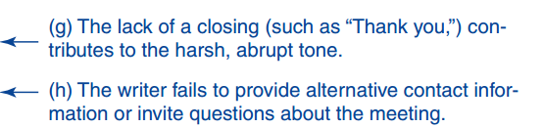
Ineffective
(f) The wording here assumes that people who won’t
attend don’t want to, which might not be true. The
writer also fails to invite questions ahead of the meeting.

Slide 14
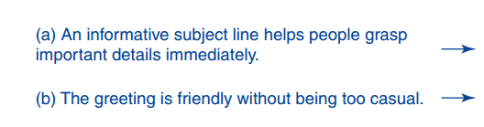
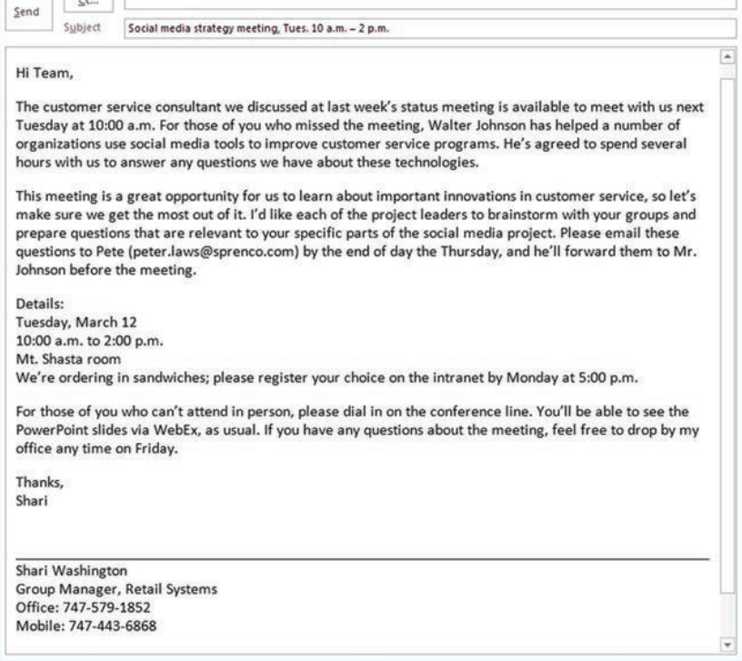



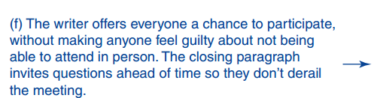
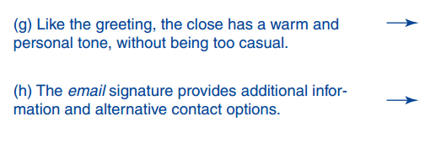

Slide 15
THIS COURSE IS DESIGNED TO TEACH YOU HOW TO WRITE IN A COMPLETE, CONCISE, CLEAR AND COMPELLING MANNER SO…

Slide 16
COMMUNICATING IN AN ORGANIZATIONAL OR PROFESSIONAL CONTEXT

Slide 17
Formal communication network
Downward communication
Upward communication
Horizontal communication
Informal communication network
Grapevine / Rumor mill

Slide 18
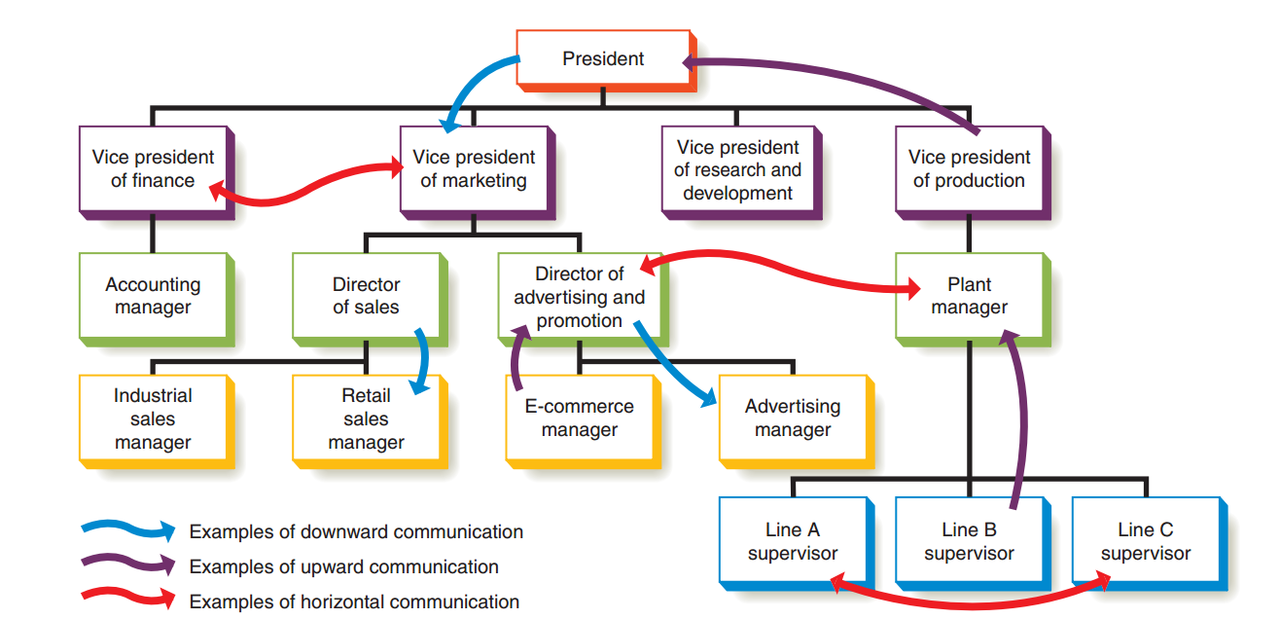

Slide 19
ADOPTING AN AUDIENCE CENTERED APPROACH FOR PROFESSIONAL COMMUNICATION
Understanding and respect audience
The ‘you’ versus ‘me’ attitude
Etiquette – the expected norms of behavior in any particular situation.

Slide 20
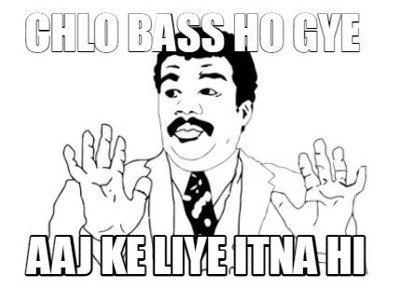

Slide 21
SOURCES
Chapter 1 and 2 of Business Communication Today 14th edition
Bovee, C. L., & Thill, J. V. (2018). Business Communication today (14th ed.). Essex, England : Pearson.

